Slide 1
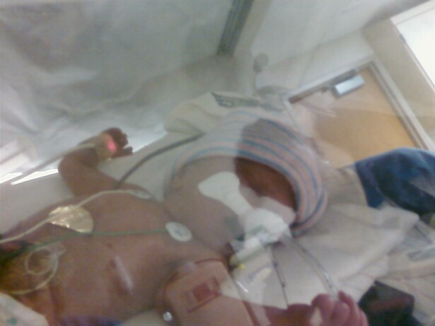
Premature Birth
By Amber Higgs
Special thanks to my brother
William Higgs

Slide 2
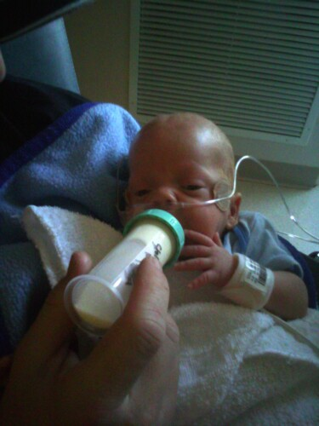
Premature births
Babies born before 37 weeks are called premature.
In the United States 12.8% of babies are born prematurely.

Slide 3
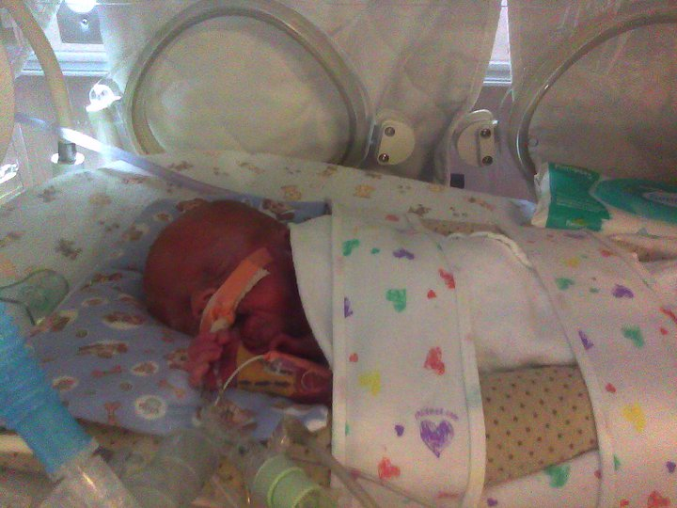
Continued
Premature births are more likely to have health problems like:
Lasting disabilities such as: mental retardation, learning and behavioral problems, cerebral palsy, lung problems and vision and hearing loss.

Slide 4
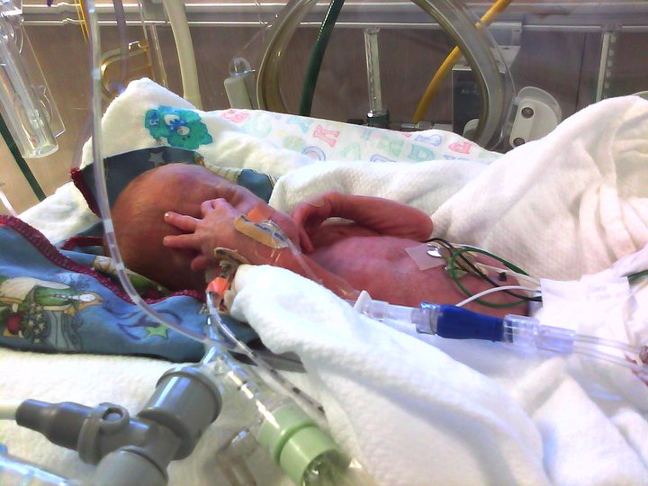
What Causes Premature Births?
(PROM) this means Premature Rupture Of the Membranes
With PROM the sac inside the uterus that holds the baby breaks too soon.

Slide 5
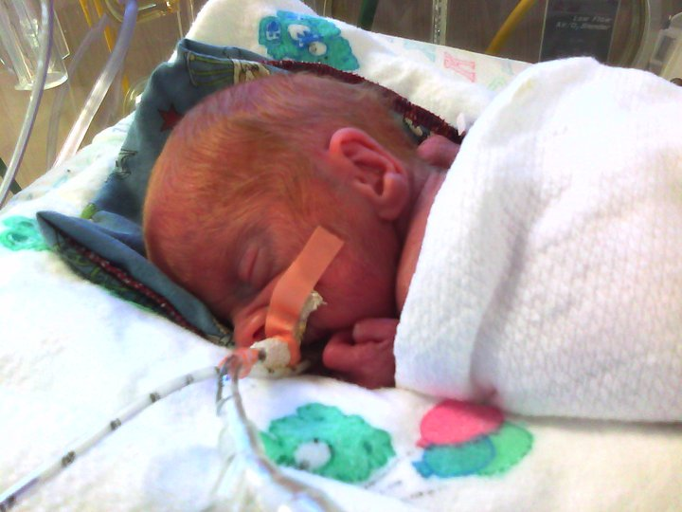
Which females are at risk?
Any female can have a premature birth.
Three groups of females are at risk:
Females that have had a previous premature birth
Females that are pregnant with twins, triplets or more.
Women with certain uterine or cervical abnormalities

Slide 6
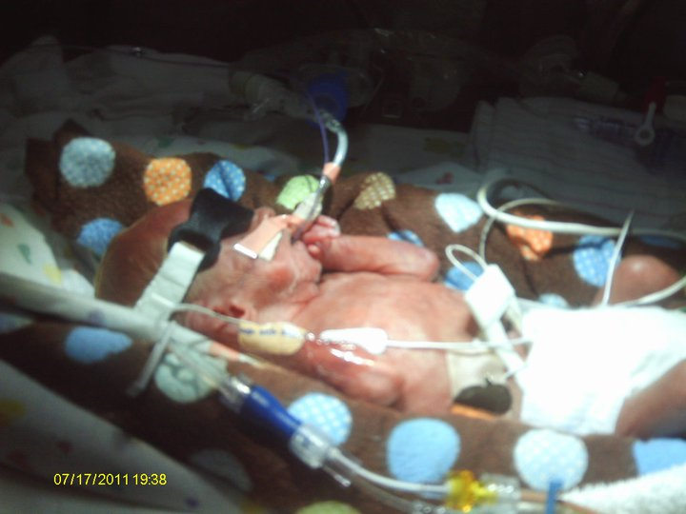
Life styles
Bad
Bad
Infections
High blood pressure
Diabetes
And more
Late or no prenatal care
Smoking
Drinking Alcohol
Using illegal drugs
Exposure to the medication DES
Domestic violence (including physical, sexual or emotional abuse)
Lack of social support
Extremely high levels of stress
Long working hours with long periods of standing
Exposure to certain environmental pollutants

Slide 7
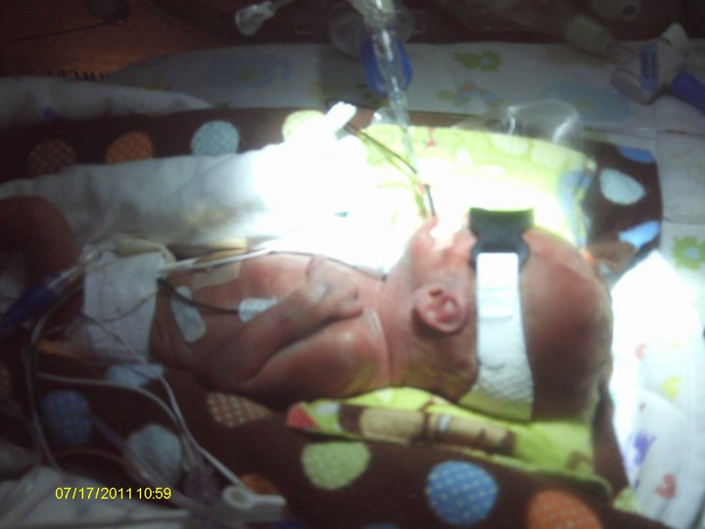
Ages
Under the age of 17
Over the age of 35

Slide 8
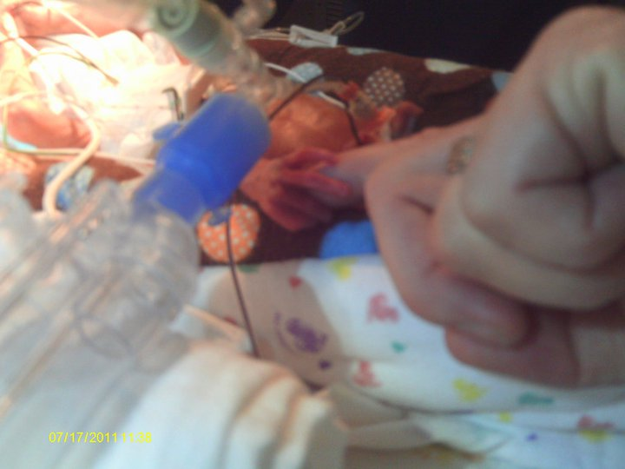
Respiratory Distress Syndrome (RDS):
About 23,000 babies a year (most of whom were born before the 34th week of pregnancy) suffer from this breathing problem. Babies with RDS lack a protein called surfactant that keeps small air sacs in the lungs from collapsing.
Treatment with surfactant helps affected babies breathe more easily. Since treatment with surfactant was introduced in 1990, deaths from RDS have been reduced by about half .
A provider may suspect a baby has RDS if she is struggling to breathe. A lung X-ray and blood tests often confirm the diagnosis.

Slide 9
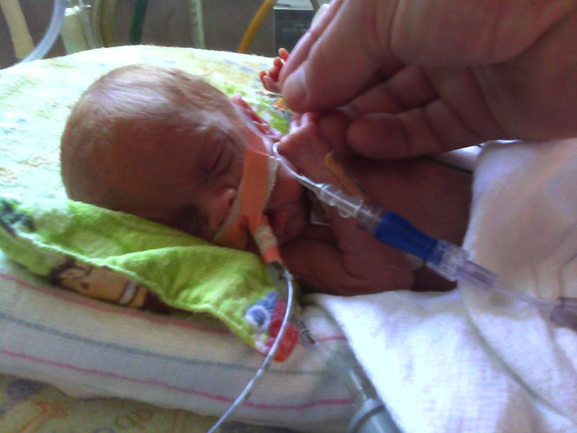
Infections
Premature babies have immature immune systems that are inefficient at fighting off bacteria, viruses and other organisms that can cause infection. Serious infections commonly seen in premature babies include pneumonia (lung infection), sepsis (blood infection) and meningitis (infection of the membranes surrounding the brain and spinal cord). Babies can contract these infections at birth from their mother, or they may become infected after birth. Infections are treated with antibiotics or antiviral drugs.

Slide 10
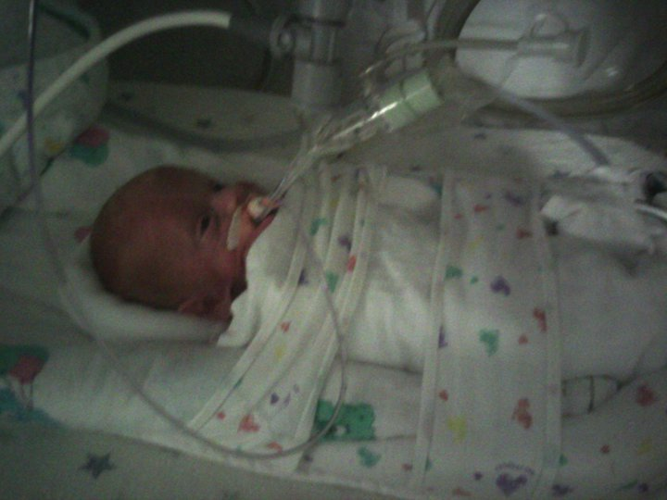
Reducing the risk of Premature births
A woman may be able to reduce her risk for premature birth by visiting her health care provider before pregnancy and, once pregnant, seeking early and regular prenatal care. A preconception visit is especially crucial for women with chronic health disorders, such as diabetes and high blood pressure, which sometimes can contribute to premature birth. When a woman receives adequate preconception and prenatal care, providers often can identify and treat pregnancy problems early, helping to reduce the risk for premature birth.

Slide 11
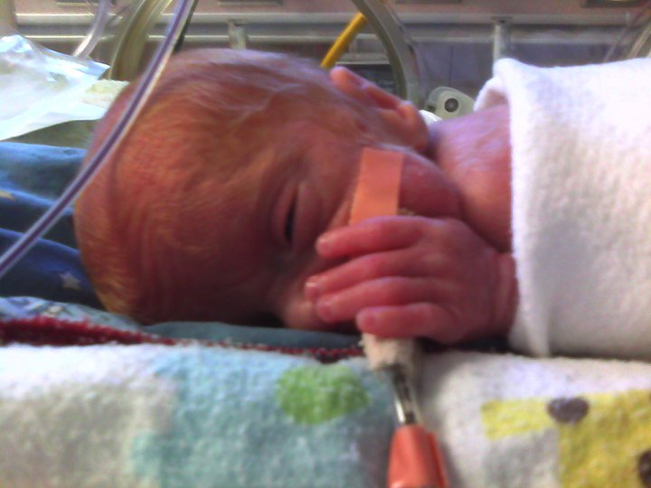
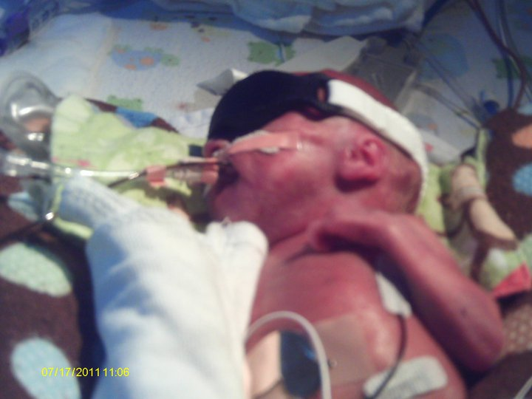
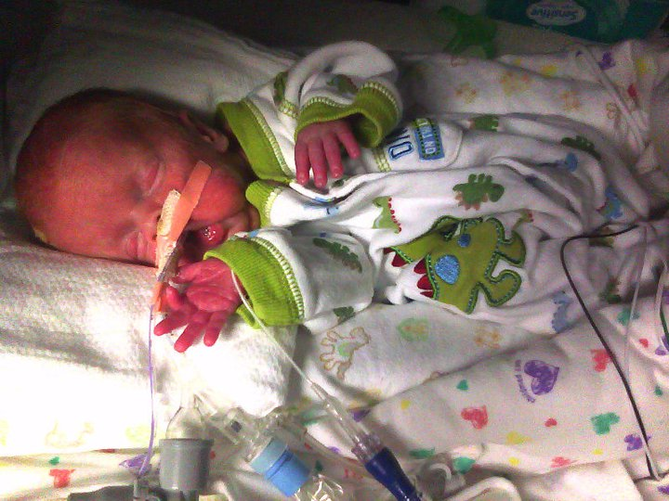
My brother is a “Premature Baby”
Thank You William Higgs

Slide 12
Sources
http://www.marchofdimes.com/baby/premature_indepth.html

